Slide 1


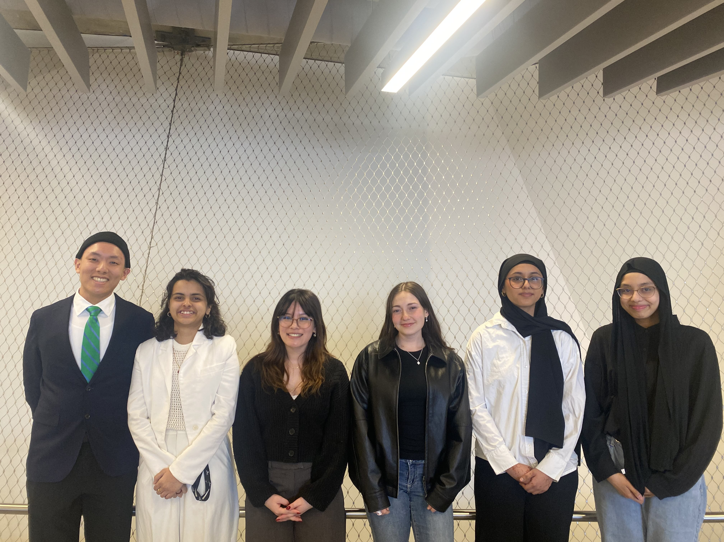
Disclaimer
This design has been prepared by first year engineering and architect students at the University of Toronto and does not present a Professional Engineering or Architecture design. A Professional Engineer or Architect has not reviewed this presentation for technical accuracy or adequacy. The recommendations of this design may not be implemented in any way unless reviewed and approved by a licensed Professional Engineer or Architect where such review and approval is required by professional or legal standards, it being understood that it is the responsibility of the recipient of the design to assess whether such a requirement exists.
The Presentation may not be reproduced, in whole or in part, without this Disclaimer.
© Engineering Strategies and Practice, University of Toronto, 2025
Permission to reproduce material from this presentation may be requested by email to your team’s contact person, with a CC to Engineering Strategies and Practice at esp@engineering.utoronto.ca
Hajir Manssour

Slide 2
Sprout Stairs: Growing Solutions for Urban Food Insecurity
ARC/ENG Team 8
Zudzin
Huang
Sakina Pirbhai
Francesca Mangano
Dina
Magdas
Sara Kabir
Hajir Manssour
April 8th, 2025
Developed for:
Danielle Whitley
Senior Associate, SvN Architects and Planners

Slide 3
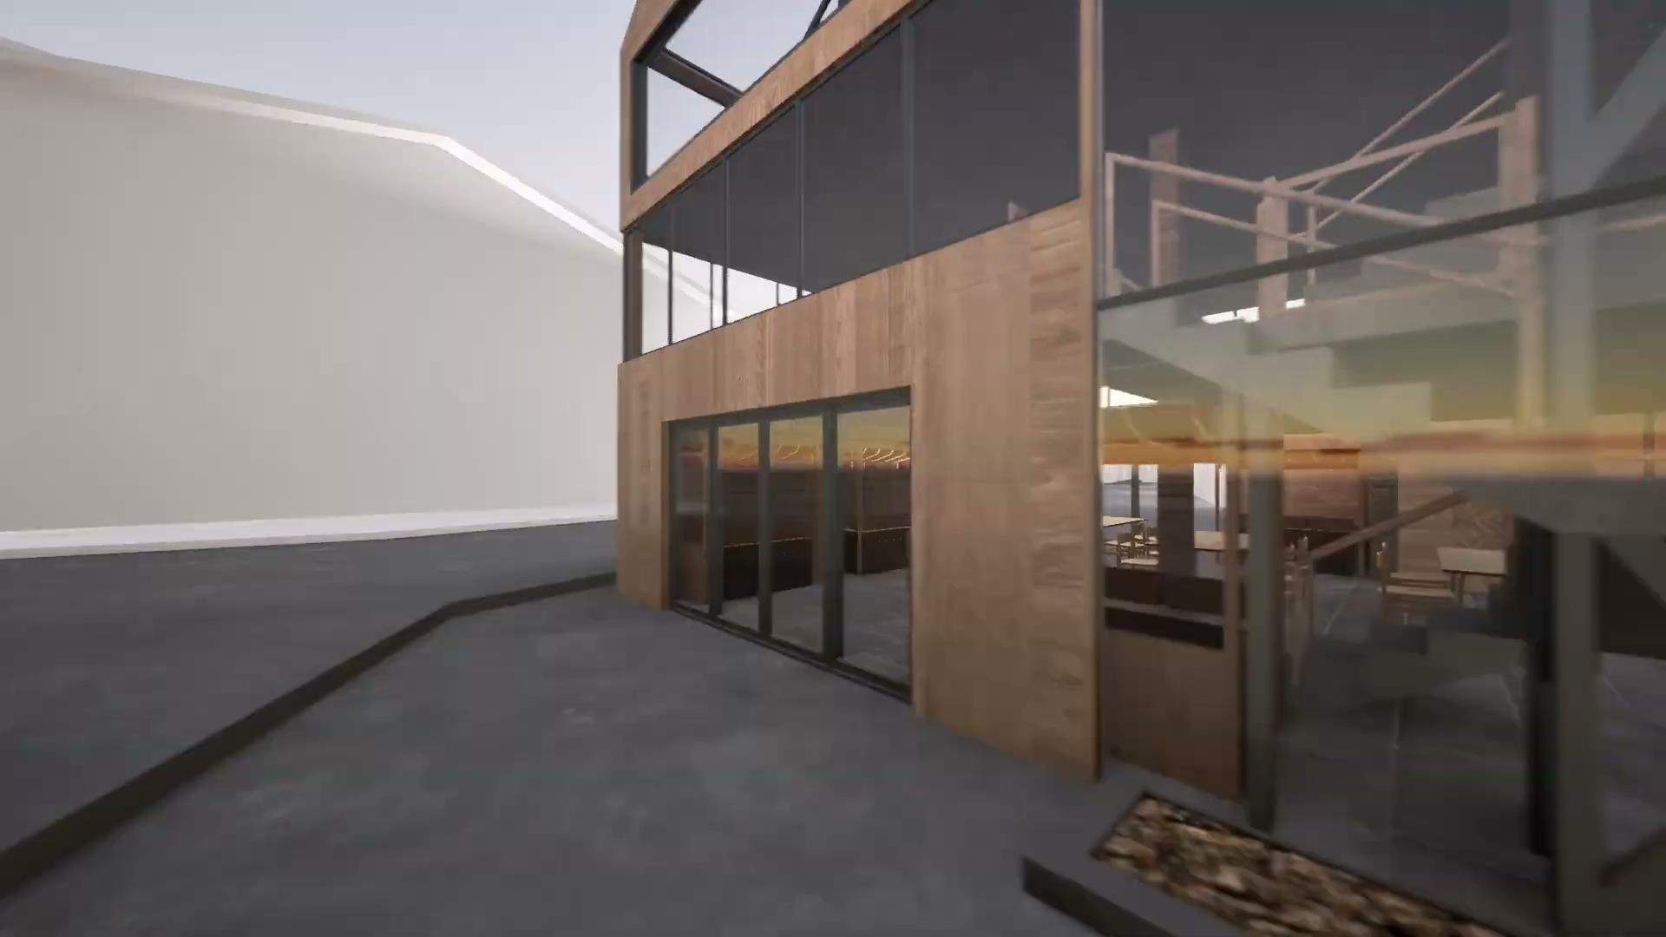


Introducing Sprout Stairs: the sustainable solution
Requirements:
Plant growing space
2 community programs
Maximization of bio-based materials
Dina Magdas
Notes:
Add more renderings to panels
Fix Kitchen Render
Add elevation to the section

Slide 4
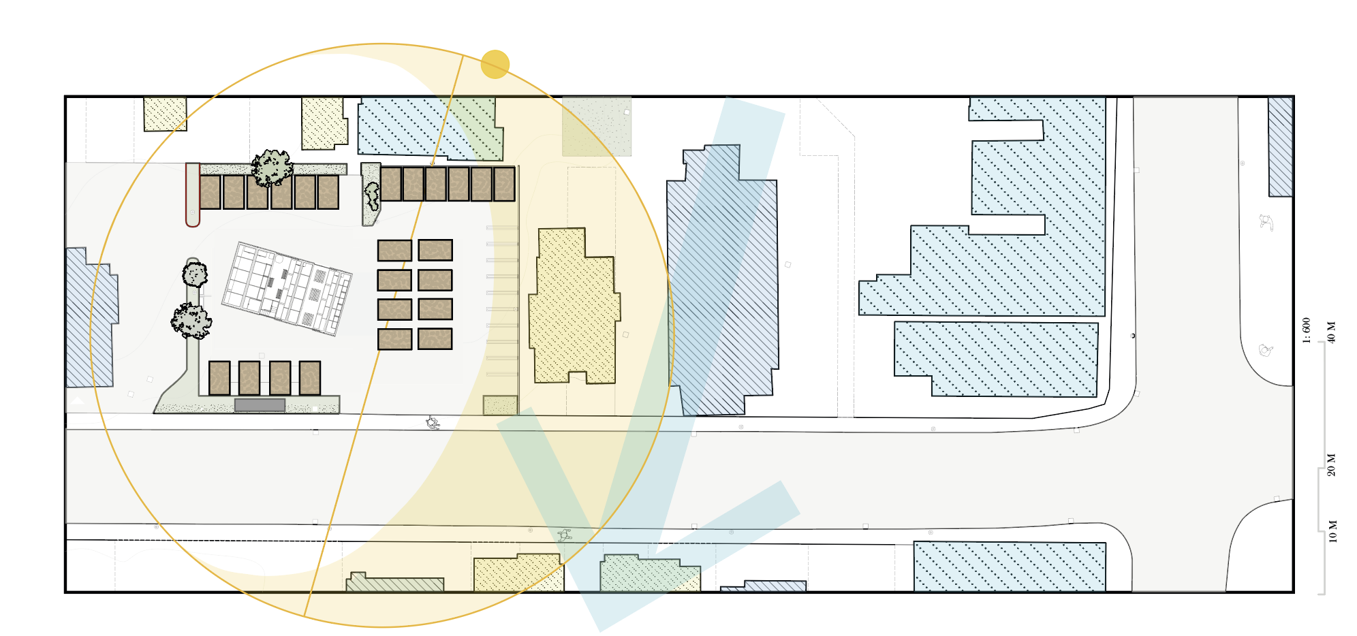
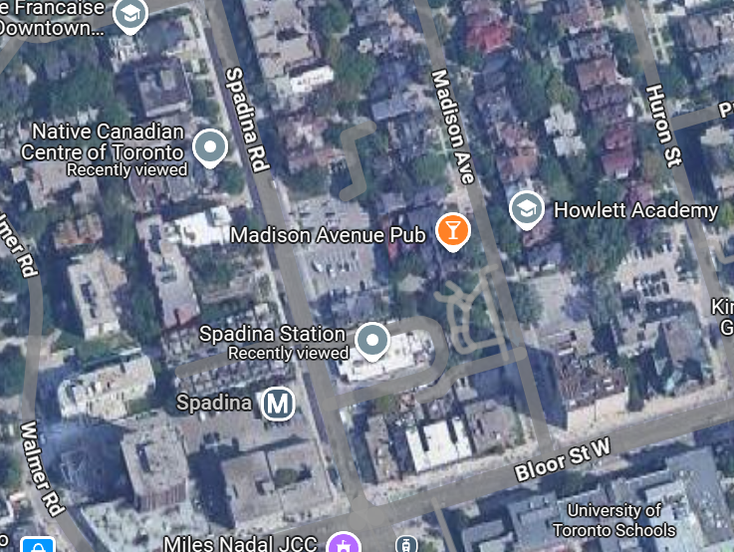


Located in the Spadina TTC Station parking lot
Native Canadian Centre of Toronto 2 mins
University of Toronto 6 mins
Lighthouse Food Bank 17 mins
The Annex, Toronto ON
Sara Kabir
Notes:
Subclaim: design tailors to community’s needs
Talk about during presentation:
How location influenced our design decisions
NCCT: growing indigenous berries
UofT: student discount
Lighthouse: partnership could ensure shelves are well stocked
The site that we aim to implement our design on is an underutilized parking lot beside Spadina Station, in a community known as the Annex. To make the most effective design that functions well within the site conditions we took into account the surrounding service environment, like the weather conditions, temperatures, sun path, and surrounding shadows. These directly influenced the orientation to maximize natural light and functionality. We also took into consideration the values of key stakeholders close to the site that we hope to partner with in order to respond to the needs of the surrounding community. As a community initiative, we hope to partner with the Native Canadian Centre of Toronto to promote indigenous cultural knowledge and grow traditional berries. As a food initiative, we hope to partner with Lighthouse food bank we hope to maximize food production by keeping our shelves stocked and minimizing food waste. And as a large number of the surrounding population of the Annex are UofT students, we hope to integrate a meal plan or student discounts as incentives for students to purchase from our greenhouse.

Slide 5
Getting to know The Annex’s community is crucial
The Annex’s median annual income is 18% lower than the Toronto average
$78,373
$64,569
Toronto
Annex
This is largely due to the high student population in the surrounding area
Francesca Mangano
Notes:
Subclaim: design tailors to community’s needs
Talk about during presentation:
Smaller household size (26% lower than Toronto average, average 1.8 people per household) also indicates high student population alongside lower birth rates and students living in single bedroom units
Users weren’t limited to students, but students are considered in special aspects of the design
Sources:
Annex median income: https://www.datalabto.ca/incomes/
Student population: https://www.toronto.ca/ext/sdfa/Neighbourhood%20Profiles/pdf/2016/pdf1/cpa95.pdf)

Slide 6
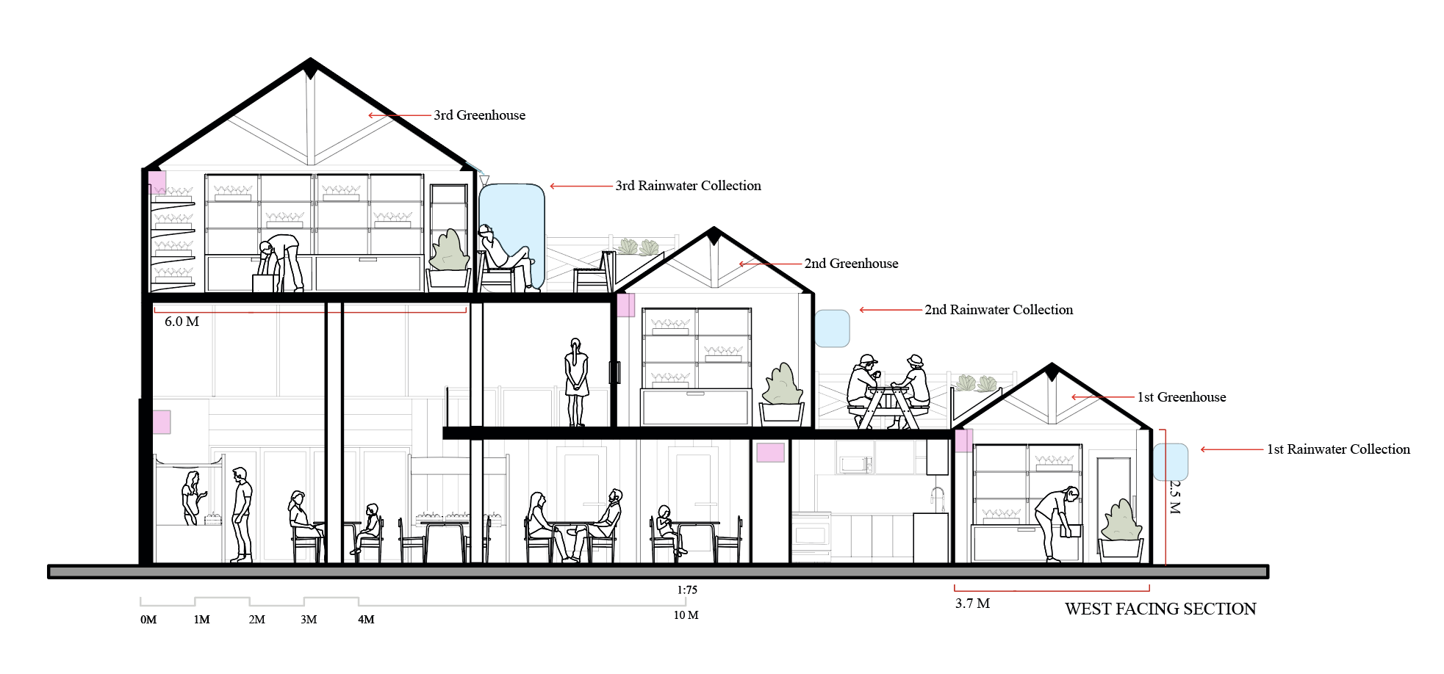
Form meets function: maximizing sunlight exposure
Dina Magdas

Slide 7
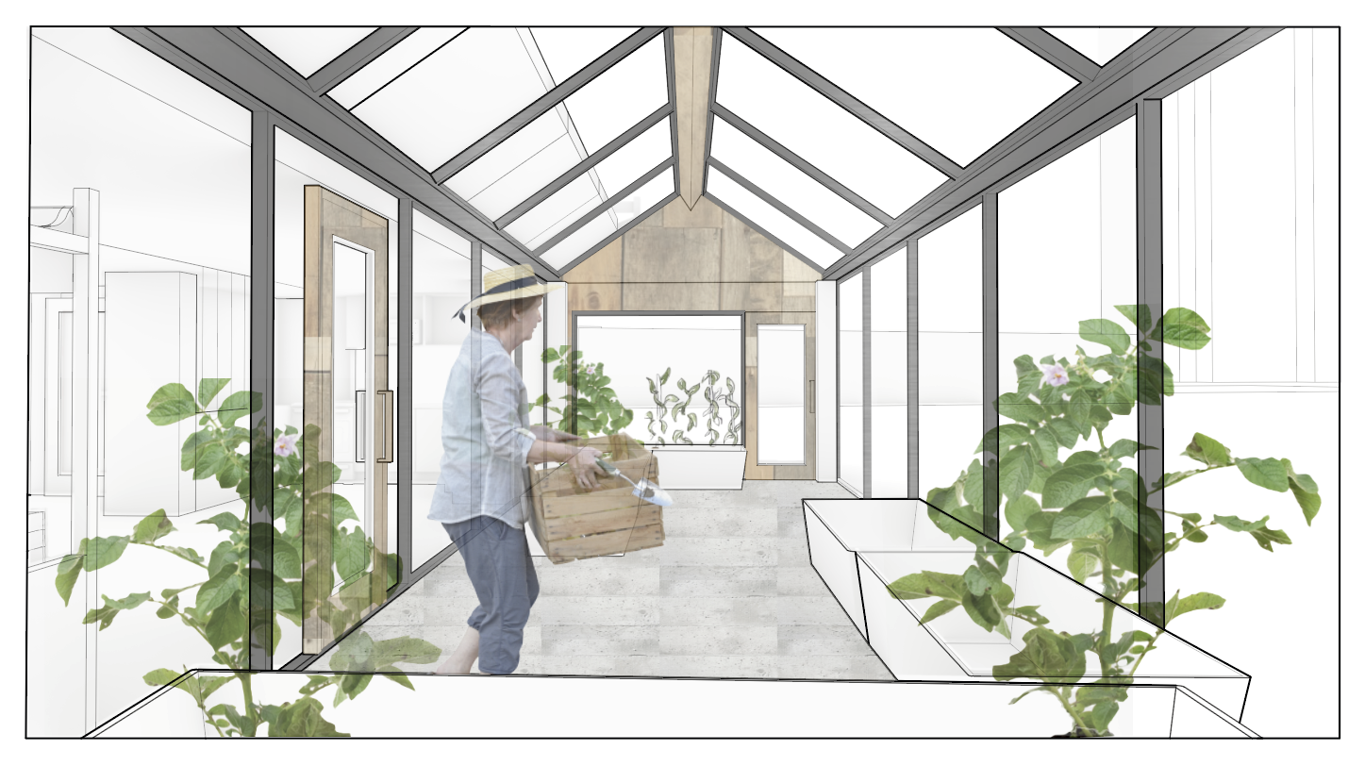
Sprout Stairs has 414 m² of plant growing area
Indoor:
26 m²
Outdoor:
373 m²
Balcony:
15 m²
This aligns with our primary objective: abundant food production
Sakina Pirbhai
Notes:
When coming up with designs, our main priority was ensuring that the community space was not more than the growing space. Through careful calculations, 414m^2 growing area was identified as ideal for the plant growing usage. This includes indoor, balcony and outdoor growing. Indoor growing will make the bulk of the year round production with balcony and outdoor growing allowing for greater summer specific plants to be grown at this time.

Slide 8
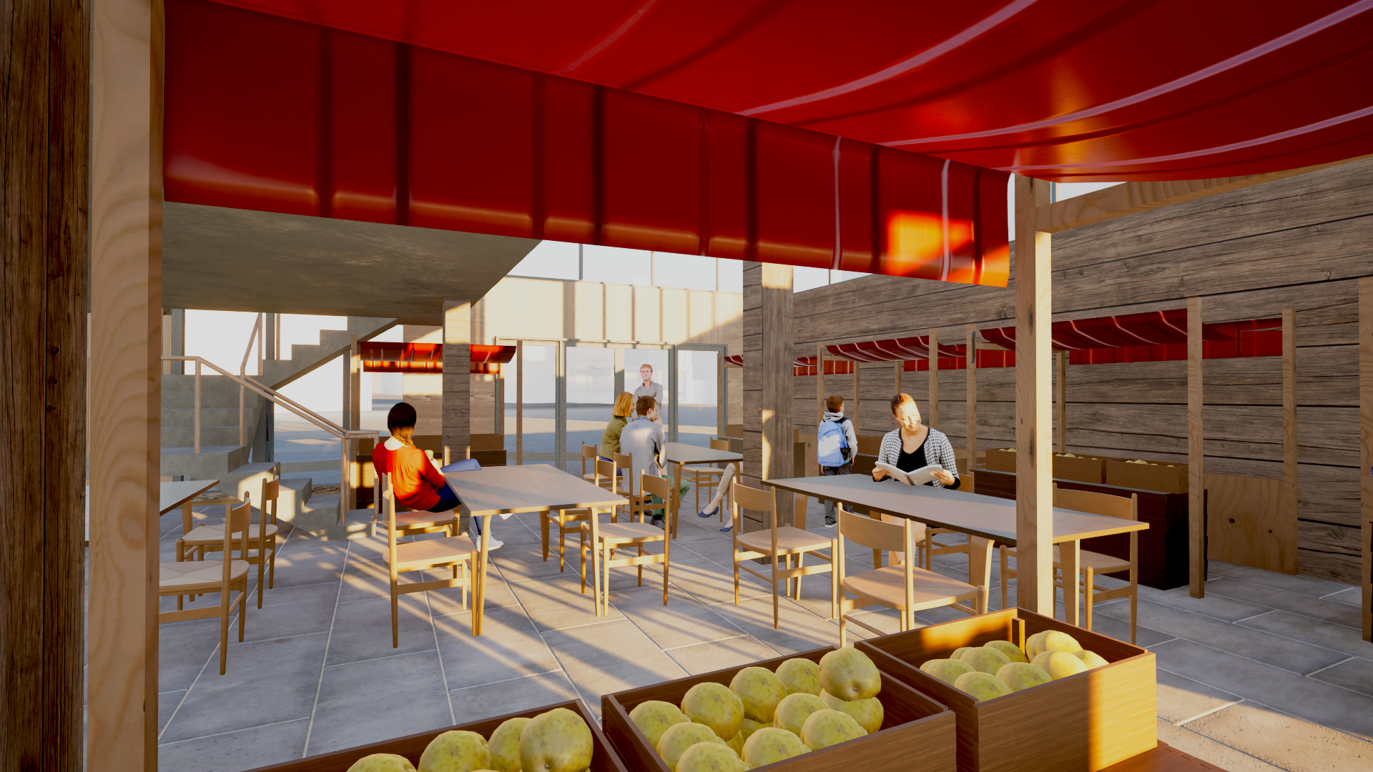
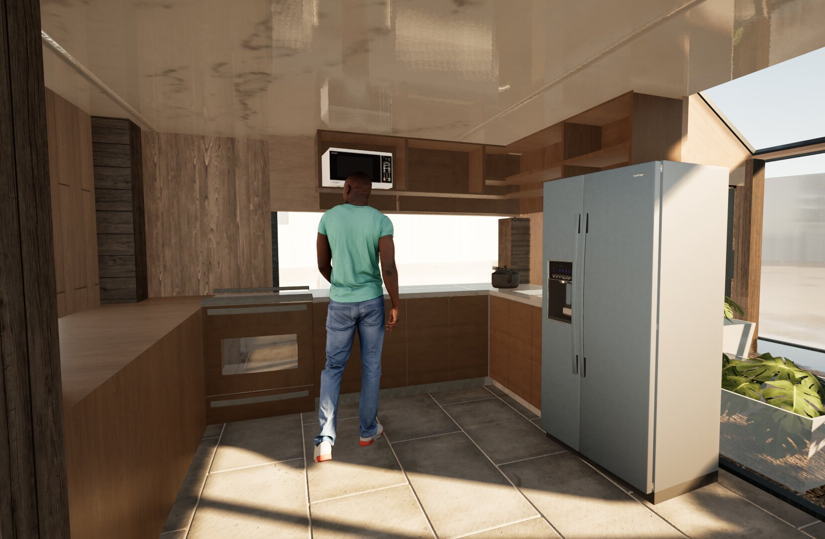
There is also community area where users can purchase and cook reduced-price produce
Hajir Manssour
This aligns with our secondary objective: increasing community utilization

Slide 9
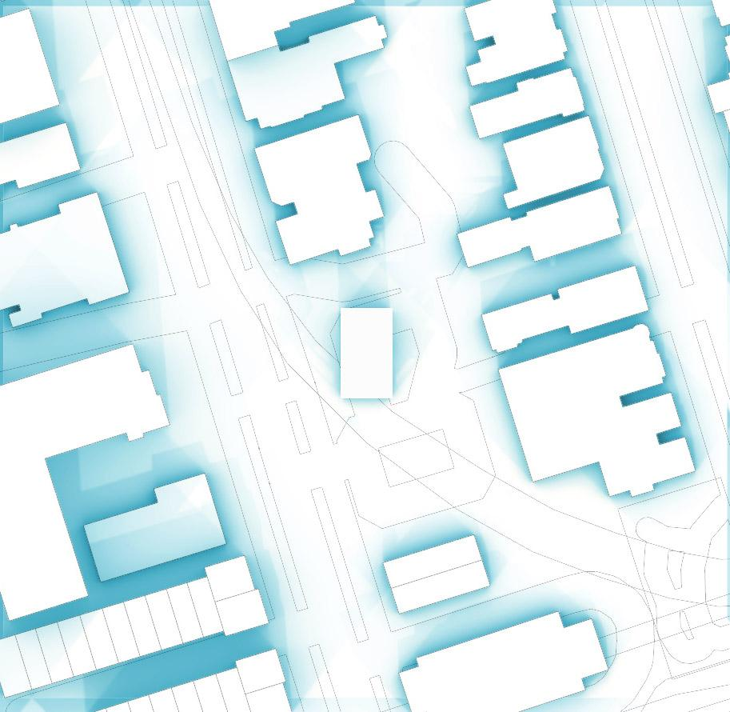
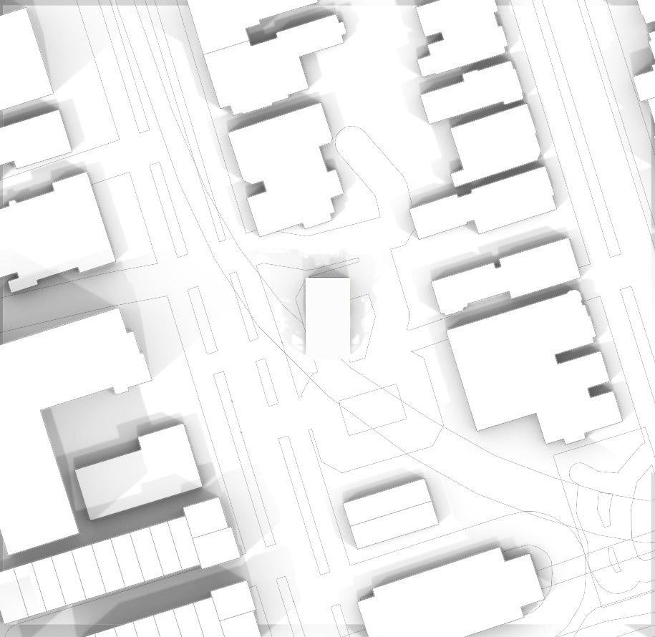
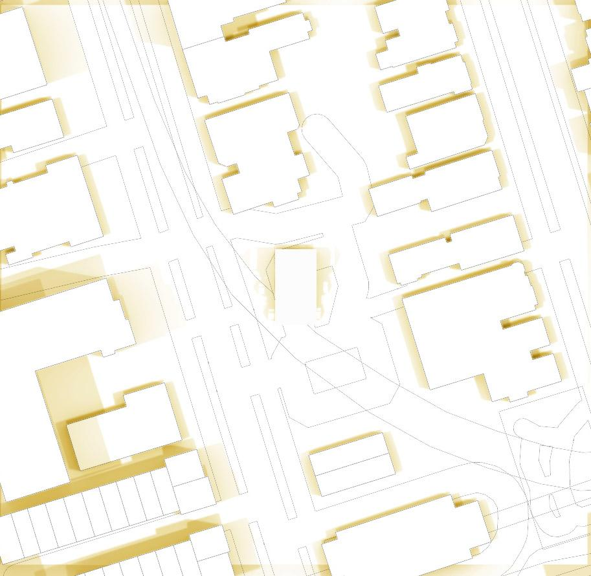
Shadow patterns greatly influenced greenhouse position and orientation
Winter solstice
Spring/fall equinox
Summer solstice
Sakina Pirbhai
Notes:
Here, you will see the

Slide 10
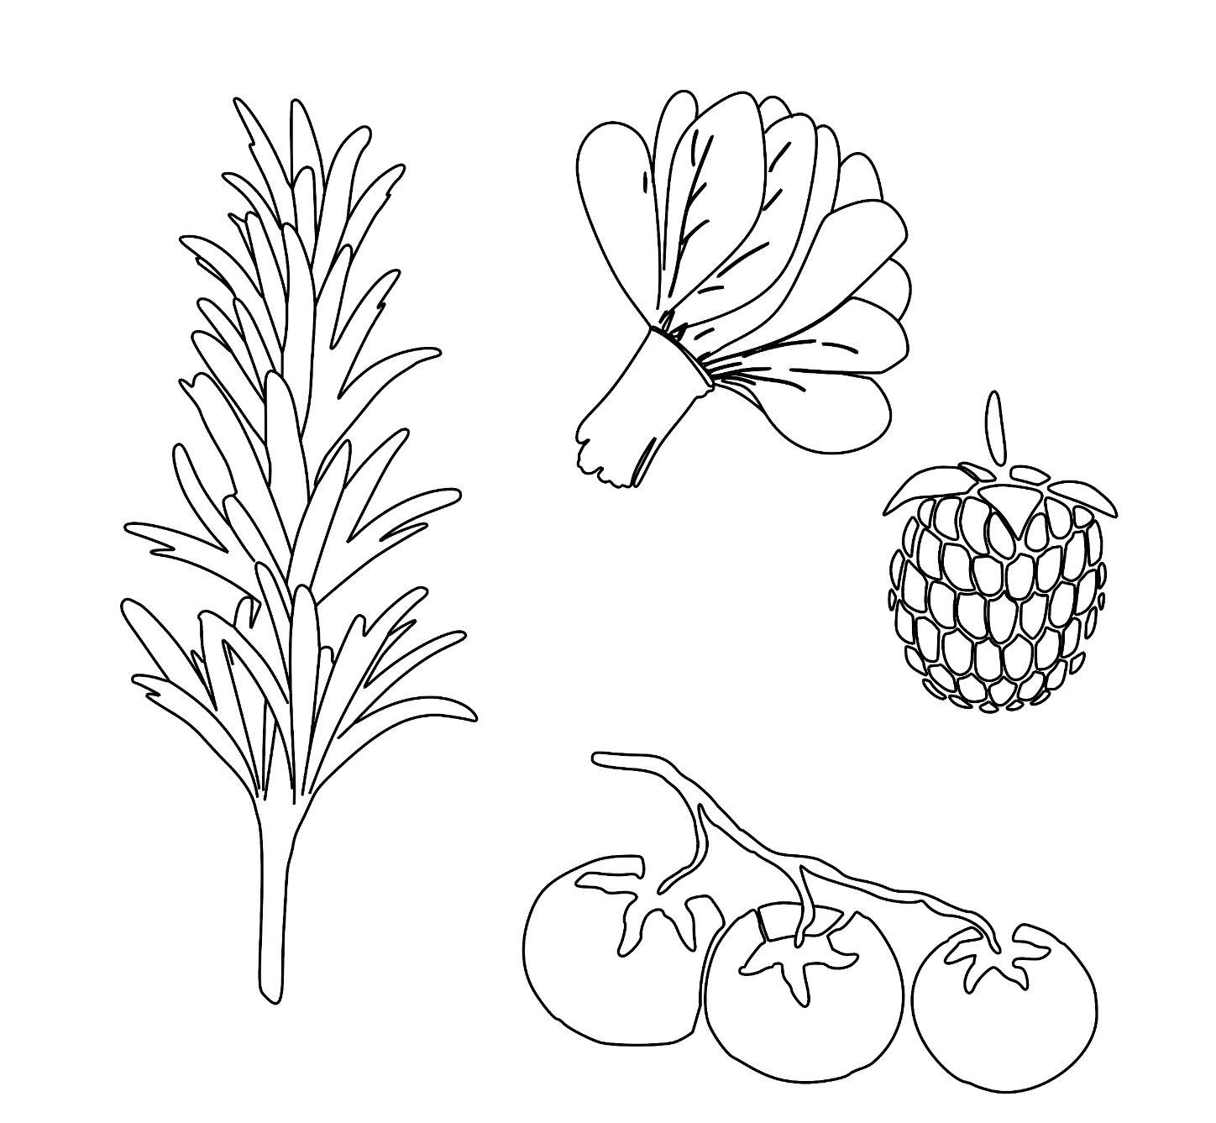
The community had a large impact on our logistical design decisions
Winter produce
Management and Logistics
Maximum cost per pound: 50¢
  35% off university student discount (must show ID)
1 manager on site
Financed by donors/partnerships and profit from sales
Herbs
Indigenous berries
Francesca Mangano
Summer produce
Notes:
Things to talk about during presentation:
Meal price was calculated using average price per person of home cooked food
Sources:
Max meal cost (https://www.thekitchn.com/have-you-ever-added-up-how-muc-63416)

Slide 11
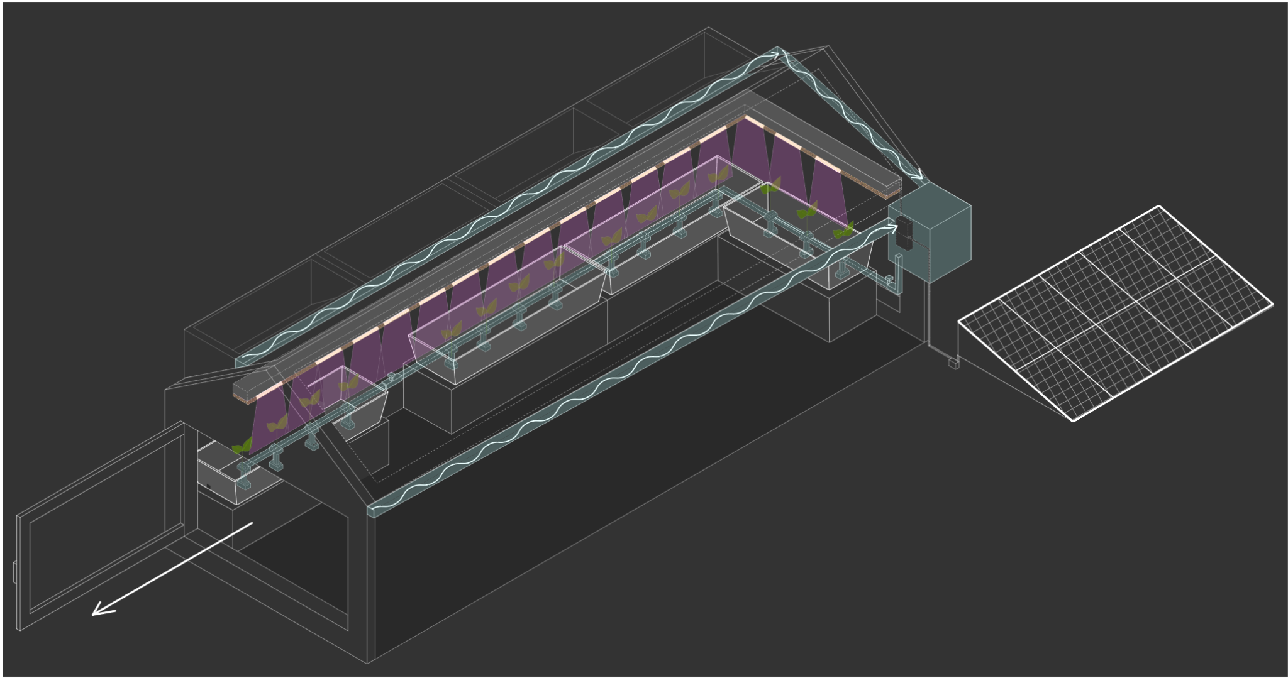
The following virtual systems were implemented to align with our foundational objectives
Rainwater efficiency
Rainwater collection system
  Used for irrigation
Optimized lighting
Supplemental LED lights over plant beds
Solar panel system on roof
Thermal stability
Operable windows
  Passive ventilation
Hajir Manssour

Slide 12
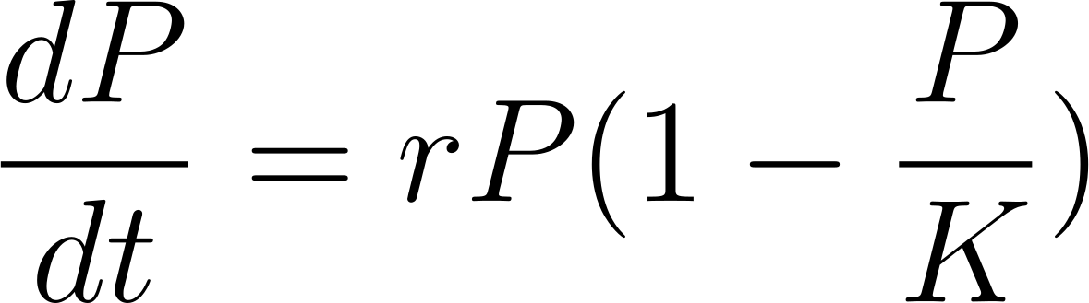
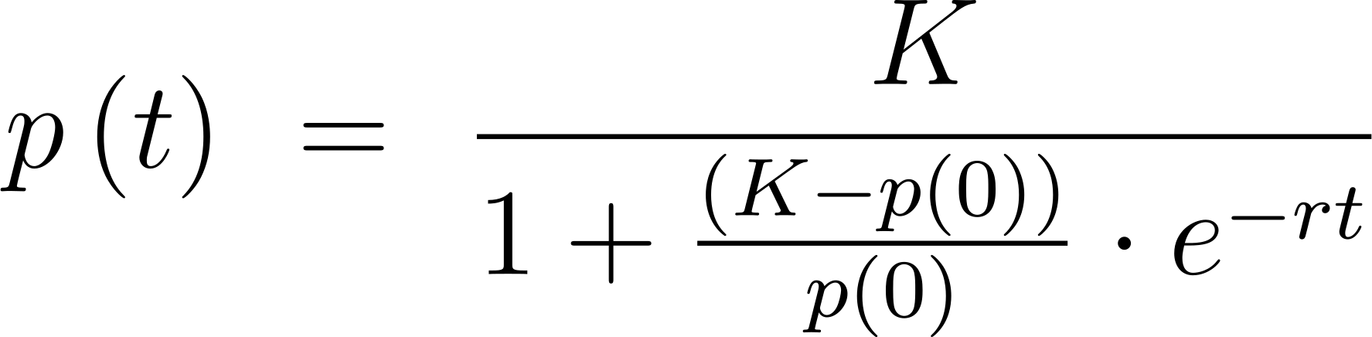
Maximizing food production is our highest priority
Goal: Produce 55.5 kg/m² of fresh food annually
Logistic Differential Equation
Solution
r = Growth Rate (year⁻¹)
K = Maximum Yield (kg/m²)
P = Design Yield (kg/m²)
p(0) = Initial Yield (kg/m²)
Zudzin Huang
Notes:
Sub-claim: design has the capability to supply the community with cost-efficient fresh food
Stuff to talk about during presentation:
“Not only do we meet this metric, but we exceed it by x
Sources:
Source for 55.5 kg/m^2/yr (https://www.sciencedirect.com/science/article/pii/S0959652616307168)

Slide 13
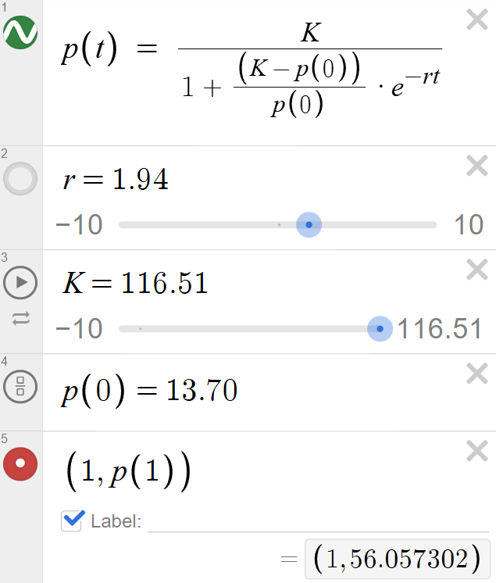
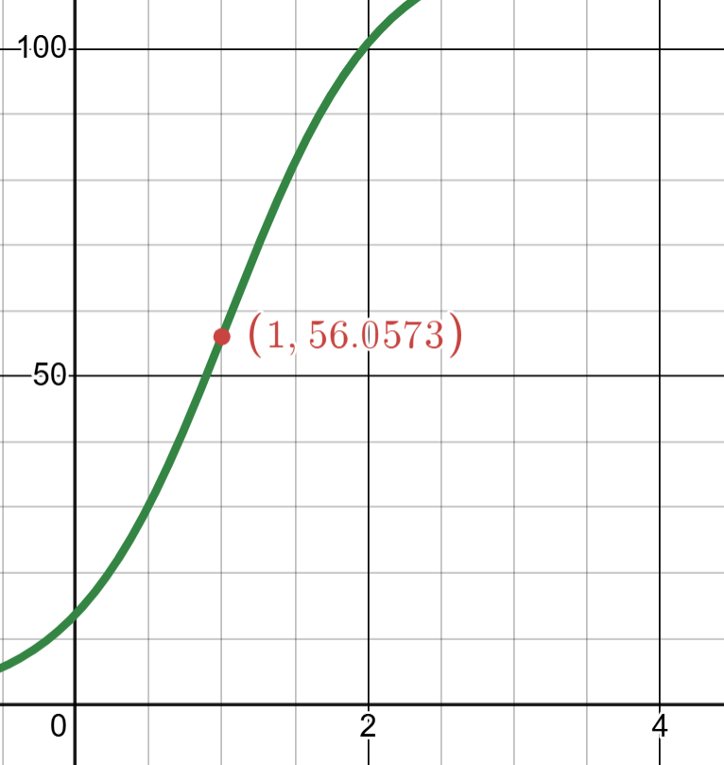
Sprout Stairs yield is 101% of our goal
Estimated Design Yield:
56.06 kg/m²
12,700 kg of produce annually
139 servings daily
X-Axis: Time (years)
Y-Axis: Yield (kg/m²)
Zudzin Huang
Notes:
Sub-claim: design has the capability to supply the community with cost-efficient fresh food
Talk about during presentation:
Why 139 servings

Slide 14
Our vision is an impactful approach to tackling food insecurity in The Annex
There is a need for a sustainable, accessible, and community-oriented source of fresh food
24.9% of Toronto households faced food insecurity in 2023
Food prices have risen 8.9% since 2015
Sara Kabir
Sara Kabir
Notes:
Sub-claim: design is tailored to fit the surrounding community’s needs
Include during presentation:
Our design vision is centered on addressing food insecurity issues and strengthening community within the Annex. Through our research, we found that nearly a quarter of Toronto residents experience food insecurity, as costs of food have risen in the past decade healthy options have become increasingly unaffordable and inaccessible. Not only does this affect individuals and families, but has an impact on the community as a whole as social isolation and division is created as stress is increased. In response, we devised a system that fulfills the Annex’s need for a sustainable, accessible and community oriented source of fresh food.

Slide 15
Next steps before implementation to maximize feeding the community
Resource Needs Assessment
Seek Partnerships
Physical:
Materials
Water
Energy
Maintenance:
Surveillance
Labour
Costs
Community initiatives:
Miles Nadal JCC
Native Canadian Centre of Toronto
Food insecurity initiatives:
Lighthouse Food Banks Canada
UTSU Food Bank
Growth Projection
Same equation with the following factors:
Rainwater
Temperature
Ventilation
Francesca Mangano

Slide 16
Appendix A: Measures of Success Calculations
Calculating r:
Using top 3 crops: tomatoes, potatoes, and lettuce
Tomato growth rate: 4.2%
Potato growth rate: 4.1%
Lettuce growth rate: 2.1%
Average growth rate: (4.2 + 4.1 + 2.1) / 3 = 3.5%
3.5% of goal: 55.5 * 0.035 = 1.94
r = 1.94

Slide 17
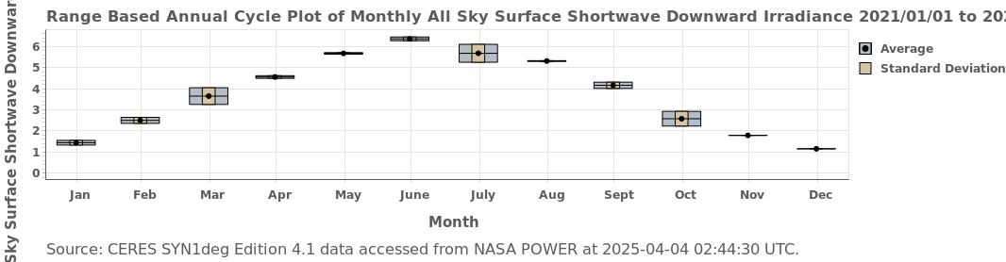
Appendix A: Measures of Success Calculations
Calculating K:
Determine amount of sunlight received using online simulation
Filter that value with our design to determine true sunlight yield
Calculate plant growth with that yield
Average the months (Nasa Power): (1.44 + 2.5 + 3.64 + 4.55 + 5.66 + 6.35 + 5.67 + 5.31 + 4.16 + 2.58 + 1.79 + 1.15) / 12 = 3.73 kW*hr/m² per day
Convert into years: 1361.45 kW*hr/m² per year
Only wavelengths from 400-700 nm are used for photosynthesis so 51.3% of the sunlight is lost at this point
Calculate viable photosynthesis wavelengths: 1361.45 * 0.487 = 663.03 kW*hr/m²

Slide 18
Appendix A: Measures of Success Calculations
Calculating K:
Tomato energy growth requirement: 13.4 kW*hr/kg
Potato energy growth requirement: 0.89 kW*hr/kg
Lettuce energy growth requirement: 1.7 kW*hr/kg
Average energy growth requirement: (13.4 + 0.89 + 1.7) / 3 = 5.33 kW*hr/kg
Tuning for our design: glass polarization is negligible
Growing area: 25.581 m² (indoor) + 14.567 m² (balcony) + 373/2 m² (outdoor, half year) = 226.648 m²
% loss: area of shadows / area of greenhouse = 14.365 m² / 226.648 m² = 6.34%
Adjusting energy based on shadows: 663.03 kW*hr/m² * 0.9366 = 620.99 kW*hr/m²
K = 620.99 kW*hr/m² / 5.33 620.99 kW*hr/kg = 116.5kg/m²

Slide 19
Appendix A: Measures of Success Calculations
Determining p(0):
Tomato: 10 plants/m², 713 g/plant → 7.13 kg/m²
Potato: 40 plants/m², 615 g/plant → 24.6 kg/m²
Lettuce: 60 plants/m², 156 g/plant → 9.36 kg/m²
Average = 13.7 kg/m²
p(0) = 13.7 kg/m²
P(t) = 116.51 / ((1 + (116.5 - 13.7) / 13.7) * e^{-1.94t})

Slide 20
Appendix A: Measures of Success Calculations
Calculating servings:
226.648m² * 56.06 kg/m² = 12,705.89 kg of produce per year
12,705.89 g per year / 250g per serving = 50,823.56 servings per year
Convert to days: 50,823.56 / 365 = 139.24 servings daily

Slide 21
Appendix B: Measures of Success Sources
Objective Goal:
G. M. Dias et al., "Life cycle perspectives on the sustainability of Ontario greenhouse tomato production: Benchmarking and improvement opportunities," J. Cleaner Prod., vol. 140, pp. 831–839, Jan. 2017. [Online]. Available: https://www.sciencedirect.com/science/article/pii/S0959652616307168. [Accessed: Mar. 02, 2025].
Measures of Success Method:
V. Shehu, "Simple Logistic and Bi-Logistic Growth Used as Forecasting Models of Greenhouse Areas in Albanian Agriculture," Journal of Multidisciplinary Engineering Science and Technology (JMEST), vol. 2, no. 9, pp. 2648–2652, Sep. 2015. [Online]. Available: https://www.jmest.org/wp-content/uploads/JMESTN42351100.pdf. [Accessed: Mar. 22, 2025].
Growth Rates:
Statistics Canada, "Fruit and vegetable production, 2024," The Daily, Feb. 17, 2025. [Online]. Available: https://www150.statcan.gc.ca/n1/en/daily-quotidien/250217/dq250217b-eng.pdf?st=FnmX_4fe. [Accessed: Apr. 4, 2025].
Statistics Canada, "Canadian potato production, 2024," The Daily, Dec. 5, 2024. [Online]. Available: https://www150.statcan.gc.ca/n1/daily-quotidien/241205/dq241205f-eng.htm. [Accessed: Apr. 4, 2025].
Statistics Canada, "Lettuce have a look at some numbers," The Daily, Jul. 20, 2023. [Online]. Available: https://www.statcan.gc.ca/o1/en/plus/4143-lettuce-have-look-some-numbers. [Accessed: Apr. 4, 2025].

Slide 22
Appendix B: Measures of Success Sources
Modelling:
NASA Langley Research Center, "NASA Prediction of Worldwide Energy Resources (POWER) Data Access Viewer." [Online]. Available: https://power.larc.nasa.gov/data-access-viewer/. [Accessed: Apr. 4, 2025].
X.-G. Zhu, S. P. Long, and D. R. Ort, "Improving Photosynthetic Efficiency for Greater Yield," *Annual Review of Plant Biology*, vol. 61, pp. 235–261, Jun. 2010. [Online]. Available: https://www.annualreviews.org/doi/pdf/10.1146/annurev-arplant-042809-112206. [Accessed: Apr. 4, 2025].
Plant Growth Requirements:
E. Nederhoff, "Energy benchmarking in the covered crops industry," Tomatoes NZ, Vegetables NZ, and EECA, Mar. 31, 2022. [Online]. Available: https://www.eeca.govt.nz/assets/EECA-Resources/Energy-Benchmarking-in-Covered-Cropping.pdf. [Accessed: Apr. 4, 2025].
S. Rafiee, H. Mousavi Avval, and A. Mohammadi, "Energy inputs and crop yield relationship in potato production in Hamadan province of Iran," *Energy*, vol. 36, no. 5, pp. 2367–2371, May 2011. [Online]. Available: https://www.sciencedirect.com/science/article/pii/S0360544211000144. [Accessed: Apr. 4, 2025].

Slide 23
Appendix B: Measures of Success Sources
Shadow Light Reduction:
M. J. J. Janssen and G. P. A. Bot, "A simple model for the estimation of greenhouse transmission: Influence of structures and internal equipment," *Acta Horticulturae*, vol. 281, pp. 35–42, Jul. 1990. [Online]. Available: https://www.researchgate.net/publication/233412837_A_simple_model_for_the_estimation_of_greenhouse_transmission_Influence_of_structures_and_internal_equipment. [Accessed: Apr. 4, 2025].
Plant Spacing:
Garden Alchemy Seeds, "Square Foot Gardening Chart." [Online]. Available: https://gardenalchemyseeds.ca/pages/square-foot-gardening-chart. [Accessed: Apr. 4, 2025].
Plant Masses:
K. Johansen et al., "Predicting Biomass and Yield at Harvest of Salt-Stressed Tomato Plants Using UAV Imagery," in *ISPRS Annals of the Photogrammetry, Remote Sensing and Spatial Information Sciences*, vol. XLII-2/W13, Jul. 2019, pp. 407–414. [Online]. Available: https://isprs-archives.copernicus.org/articles/XLII-2-W13/407/2019/isprs-archives-XLII-2-W13-407-2019.pdf. [Accessed: Apr. 4, 2025].

Slide 24
Appendix B: Measures of Success Sources
L. E. A. Tulung, M. Amin, and C. N. Manoppo, "Response of growth and production of potato plants to application of NPK fertilizer," unpublished. [Online]. Available: https://www.researchgate.net/figure/The-average-of-weight-of-fresh-plant-weight-of-dry-plant-numbers-and-productivity-of_tbl1_354815537. [Accessed: Apr. 4, 2025].
J. Pickens, D. Wells, and C. Blanchard, "Greenhouse Lettuce Production," Alabama Cooperative Extension System, Aug. 5, 2022. [Online]. Available: http://www.aces.edu/blog/topics/crop-production/greenhouse-lettuce-production/. [Accessed: Apr. 4, 2025].
Desmos:
Desmos Studio PBC, "Desmos Graphing Calculator." [Online]. Available: https://www.desmos.com/calculator/trmnh8foag. [Accessed: Apr. 4, 2025].
Serving Size:
Health Canada, "My Food Guide Servings Tracker: Male Aged 19–50," 2011. [Online]. Available: https://www.canada.ca/content/dam/hc-sc/migration/hc-sc/fn-an/alt_formats/pdf/food-guide-aliment/track-suivi/table_male-homme_age19-50-eng.pdf. [Accessed: Apr. 5, 2025].

Slide 25
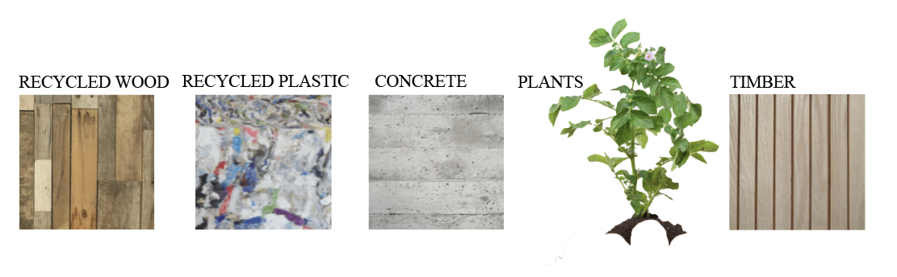

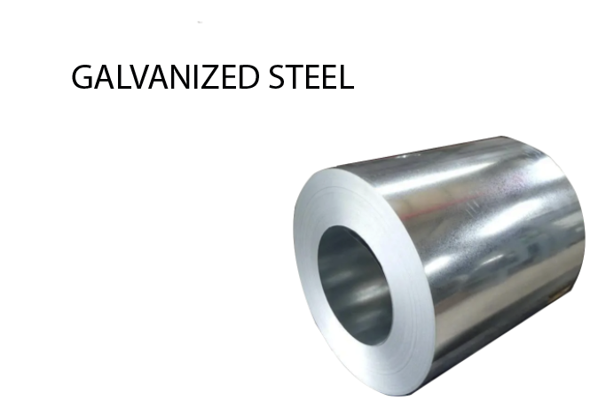
Appendix C: Material Palette
Notes:
Add steel

Slide 26
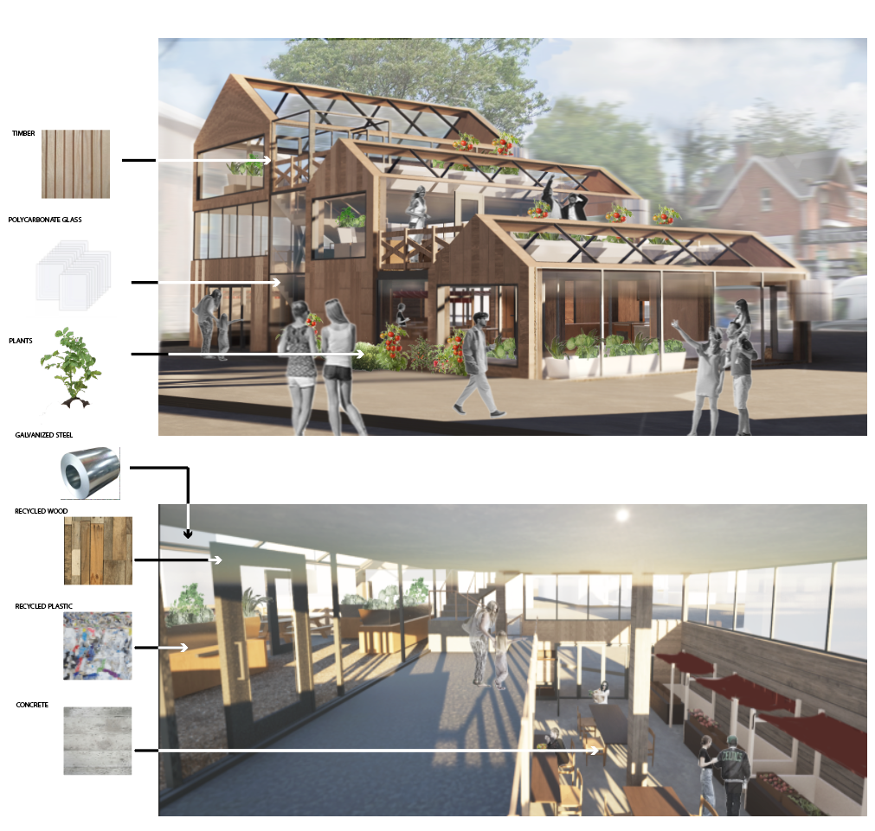
Appendix D: Hybrid Renderings
Notes:
Add steel

Slide 27
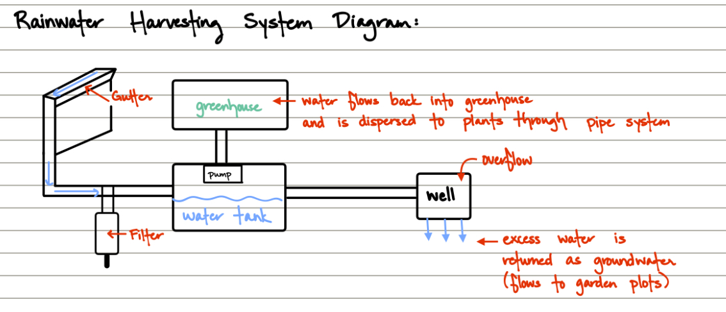
Appendix E: Rainwater
Notes:
Water is collected through gutter → is filtered → stored in water tank → excess water is collected in the well and flows back into the ground → filtered water flows into the greenhouse through pipes connected under each plant bed. PLACEMENT: filter connected to pipes between each water tank, well outside of greenhouse

Slide 28
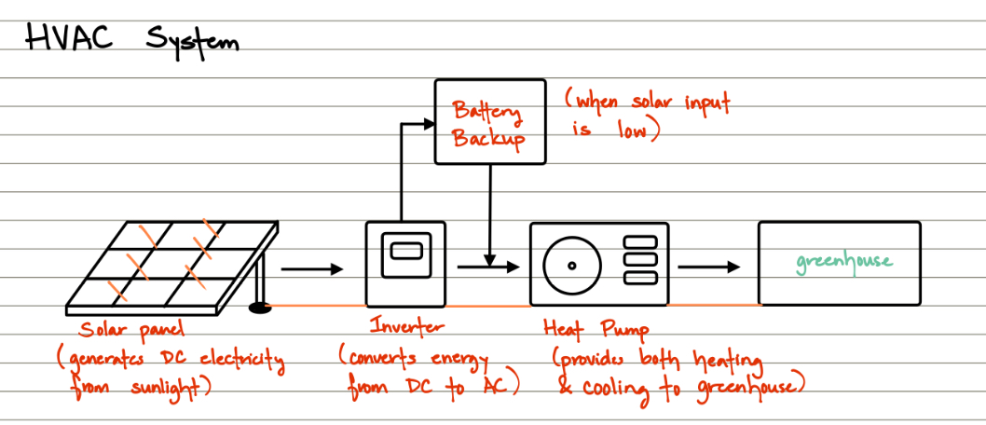
Appendix F: HVAC/Energy
Notes:
Solar panel absorbs solar energy → inverter converts DC to AC for consumption → heat pump generates both heating and cooling for greenhouse. Solar energy will likely not be enough to power whole greenhouse so a battery backup will be used to generate power when energy is low. PLACEMENT: inside greenhouse walls

Slide 29
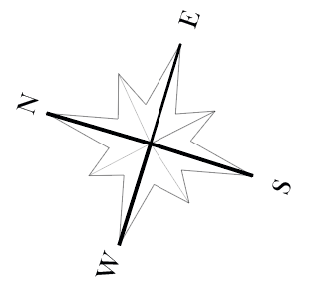
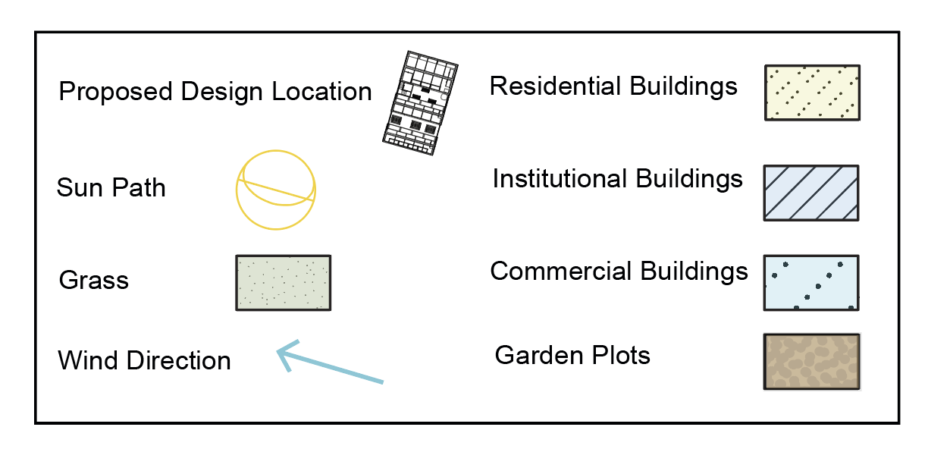
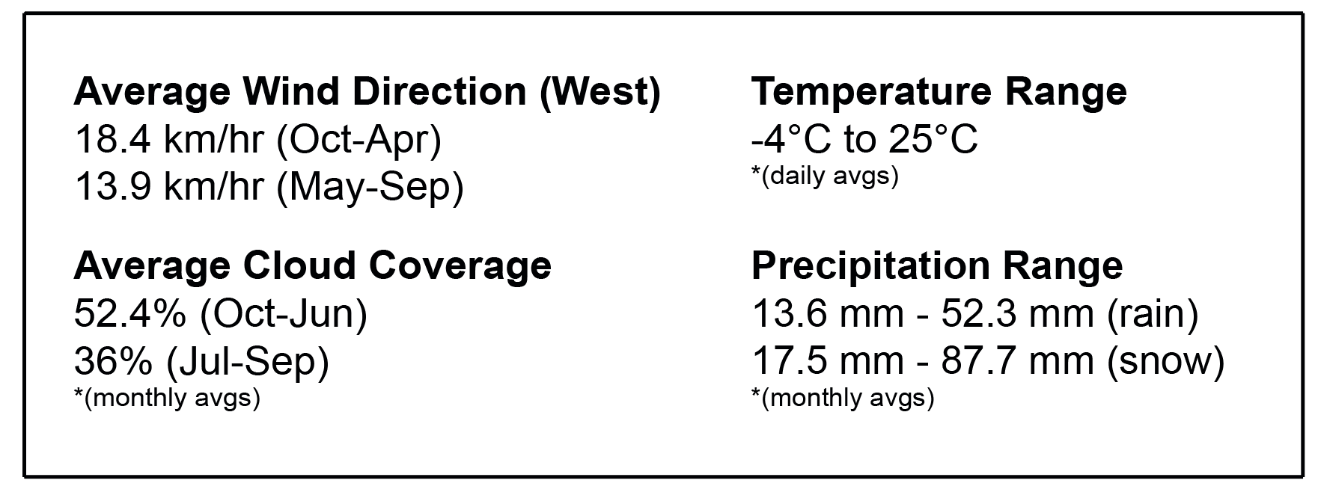
Appendix G: Location of Sprout Stairs on Site
Location: north section of the site to optimize shadows created by surrounding buildings
Orientation: plant growing area faces south to optimize sunlight

Slide 30
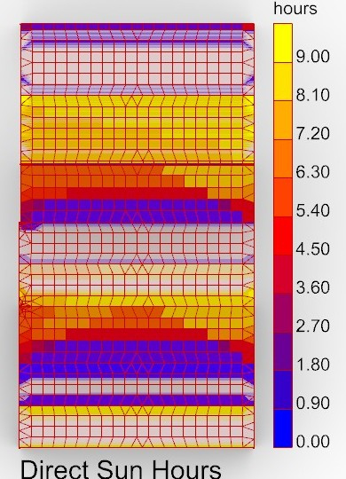
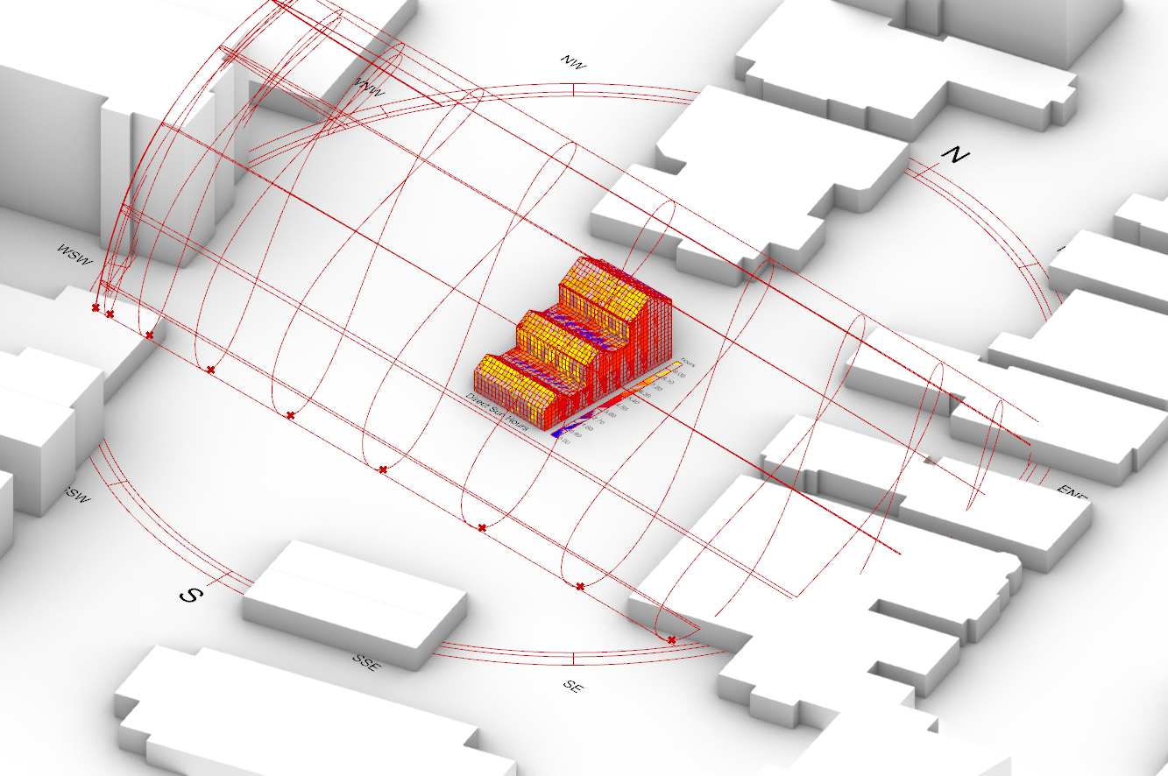
Appendix H: Sun Studies

Slide 31
Appendix I: User Group
The greenhouse is open to anyone who needs it, however, the following groups had an impact on our design
High School and University Students
Cultural Communities
Proximity to University of Toronto
  35.6% of population are from age 15-30 (student age)
Partnerships with the following organizations
  NCCT
  Lighthouse (refugee groups, Vietnamese community)
  Miles Nadal Jewish Community Center

Slide 32
Appendix J: Specific Plants Being Grown
Winter Produce
Year Round Produce
Leafy greens
Lettuce
Carrots
Potatoes
Strawberries
Tomatoes
Onions
Peppers
Cucumbers
Indigenous Produce
Herbs
Huckleberries
Elderberry
Rhubarb
Oregano
Mint
Rosemary

Slide 33
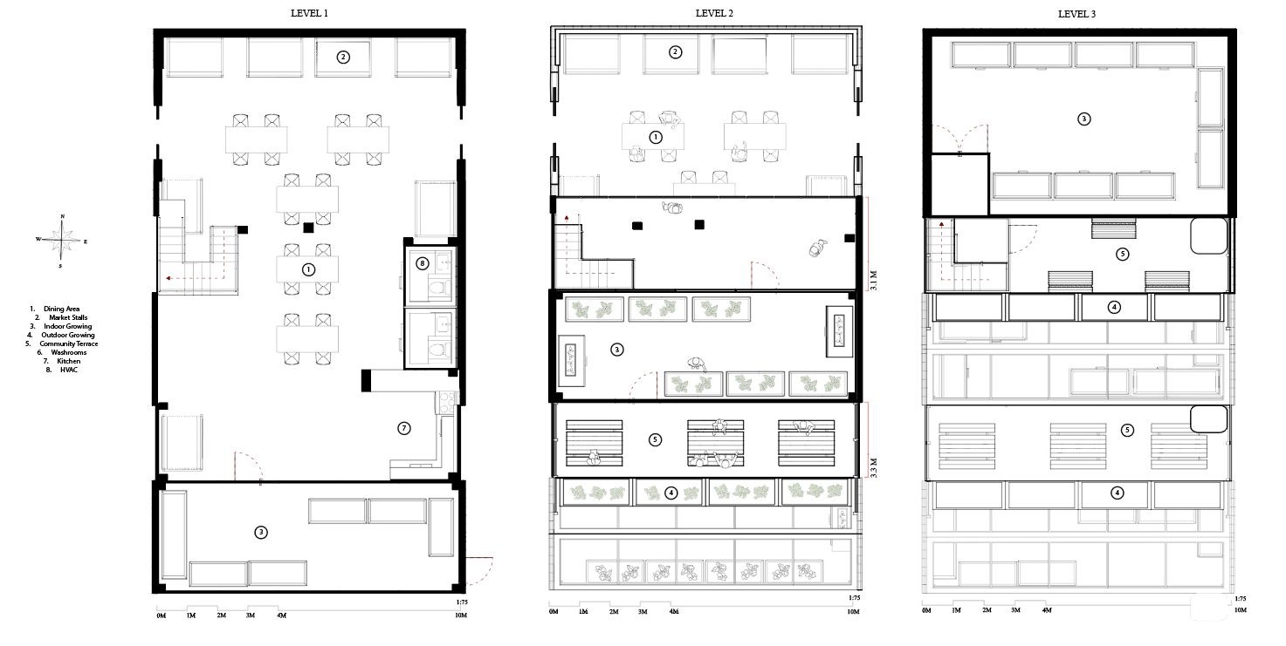
Appendix K: Floor Plans

Slide 34
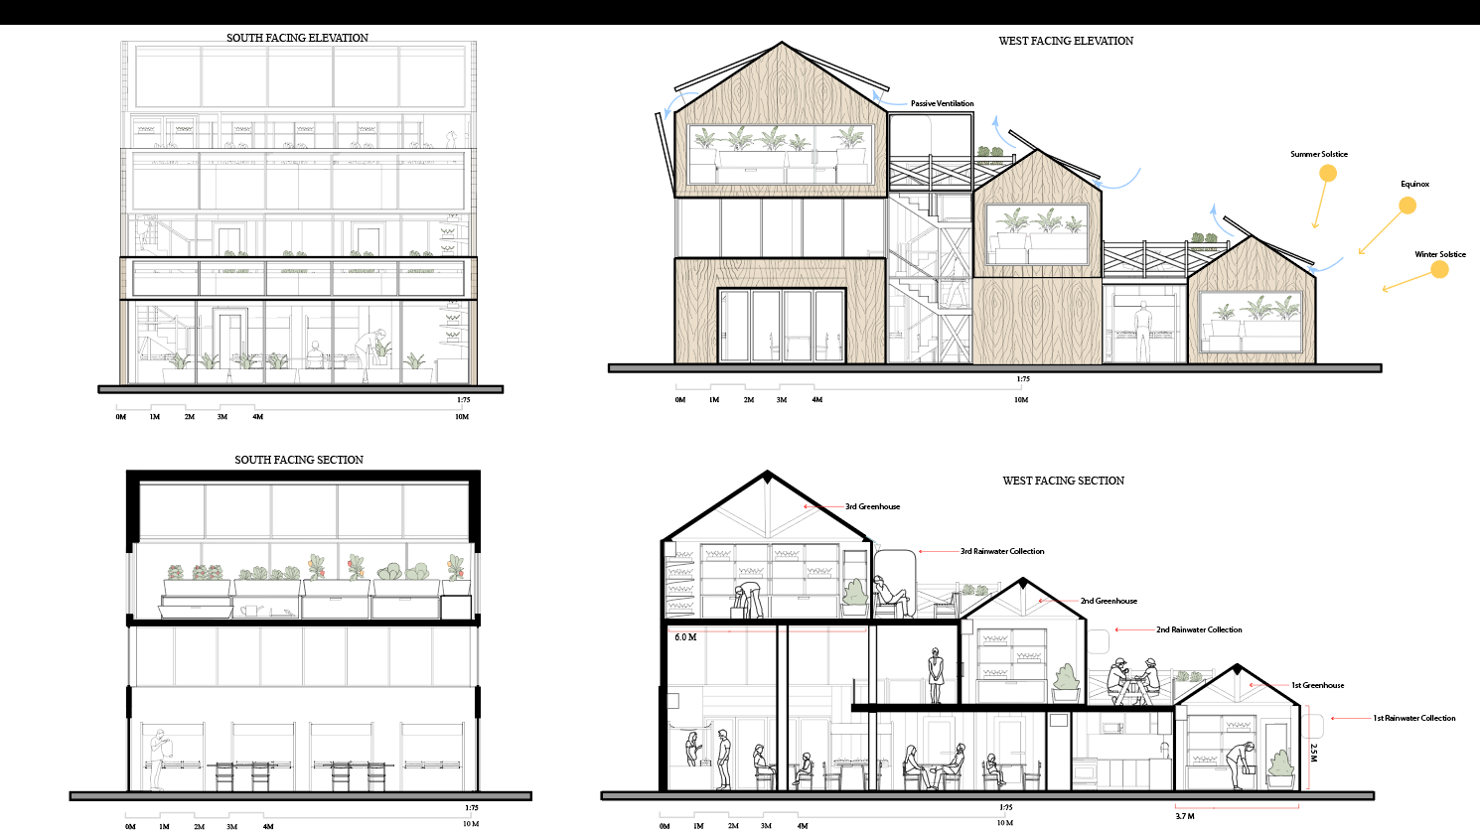
Appendix L: Western and Southern Sections/Elevations

Slide 35
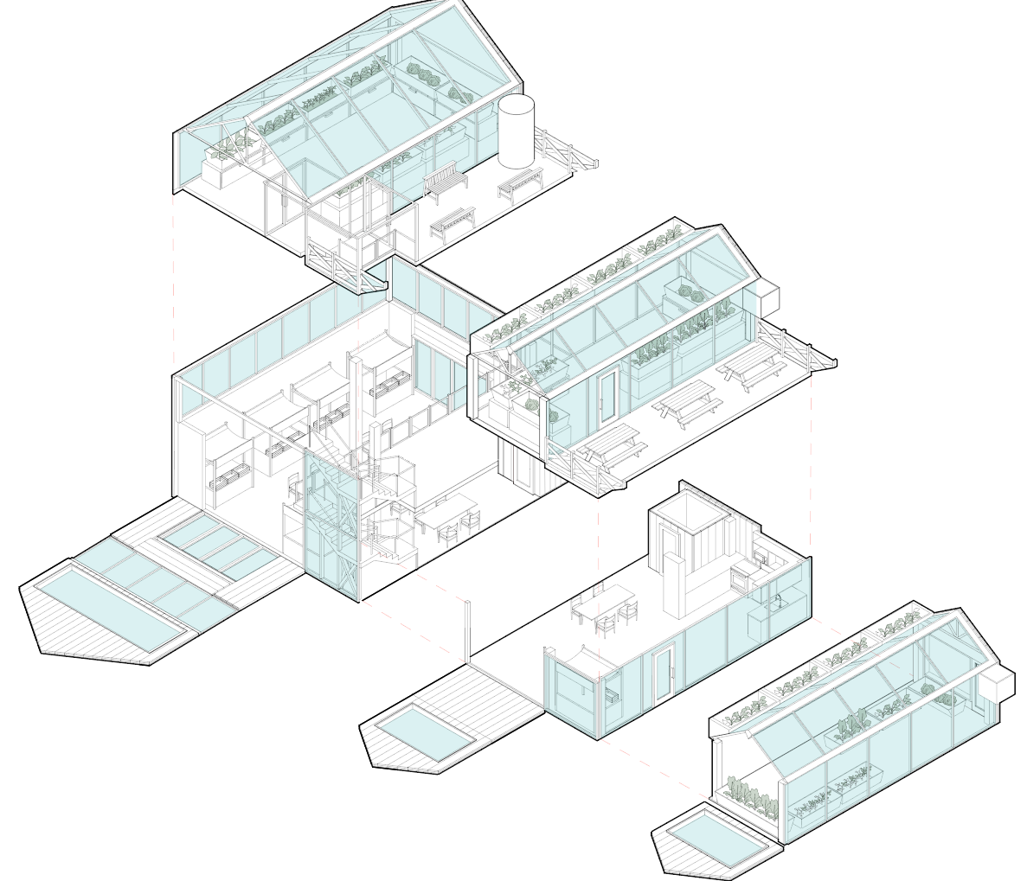
Appendix M: Exploded Axonometric

Slide 36
Appendix N: Average Weather
Wind
Temperature Range
Average Wind Direction: West
18.4 km/hr (Oct-Apr)
13.9 km/hr (May- Sept
-4ºC to 24ºC
  * Daily Avgs
Average Cloud Coverage
Precipitation Range
52.4% (Oct-Jun)
36% (Jul-Sep)
  *(Monthly Avgs)
13.6 mm-52.3 mm (rain)
17.5 mm-87.7 mm (snow)
  *(Monthly Avgs)

